Slide 1
PeopleAdmin Performance Management
User Guide
UNT Dallas
2023 Evaluation Period

Slide 2
FY 2023 UNT Dallas Performance Schedule
2023 Evaluation Period | 6/1/2022-3/31/2023
Employee Creates Plan | 11/07/2022-11/18/2022
Supervisor Acknowledges Plan | By 12/02/2022
Mid-Year Check-In | 1/2/2023-1/31/2023
Self-Evaluation | 4/3/2023-4/14/2023
Supervisor Evaluation | By 4/30/2023
Supervisor Meets with Employee | By 4/30/2023
Employee Acknowledges Evaluation | By 4/30/2023

Slide 3
Steps of Review Program – FY 2023
Employee Creates Plan - Employee enters Goal(s) or Objective(s) from last year's performance review cycle
Supervisor Acknowledges Plan – Supervisor reviews and acknowledges entries
Mid-Year Check In – Supervisor meets with employee to review progress toward goals or objectives
Self-Evaluation – Employee rates self
Supervisor Evaluation – Supervisor provides feedback and selects an overall performance rating
Supervisor Meet with Employee – Supervisor meets with employee to review the supervisor evaluation
Employee Acknowledges Evaluation – Employee acknowledges receipt of the evaluation

Slide 4
Accessing the Performance Module
Via employee portal link: https://my.untsystem.edu
  Go to the PeopleAdmin section
  Select the link for Staff Performance Evaluation
Log-in with EUID and Password
All supervisors and employees can access system
Users can also access via the Employee Portal (slide 16) or through PeopleAdmin (slide 17)

Slide 5
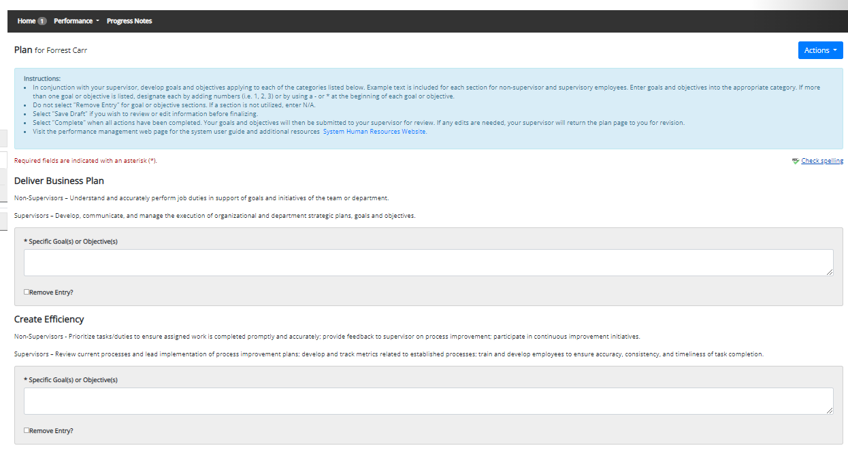
Employee Creates Plan
The first step in the evaluation program is for the employee to create the evaluation plan.
The employee and the supervisor work together to develop goals and objectives for each of the identified categories within the performance evaluation plan.
The employee will enter the developed goals and objectives into the PeopleAdmin system, scrolling down the page to select “Save Draft” to save work in progress and to select “Complete” when ready to submit to supervisor.

Slide 6
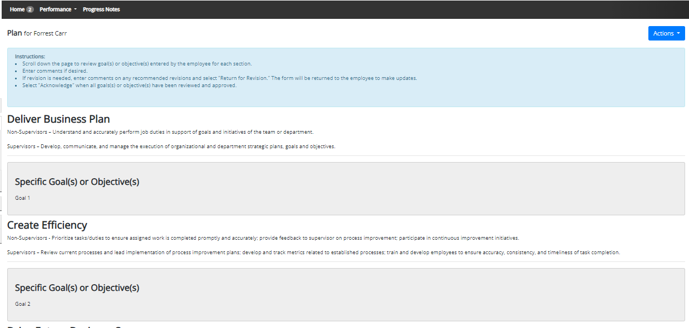
Supervisor Acknowledges Plan
In the second step, the supervisor will receive the completed plan for review and acknowledgement.
If changes are needed, the supervisor can scroll to the bottom of the page to add comments and select “Return for Revision.” If no changes are needed, the supervisor can select “Acknowledge” to complete the task.

Slide 7
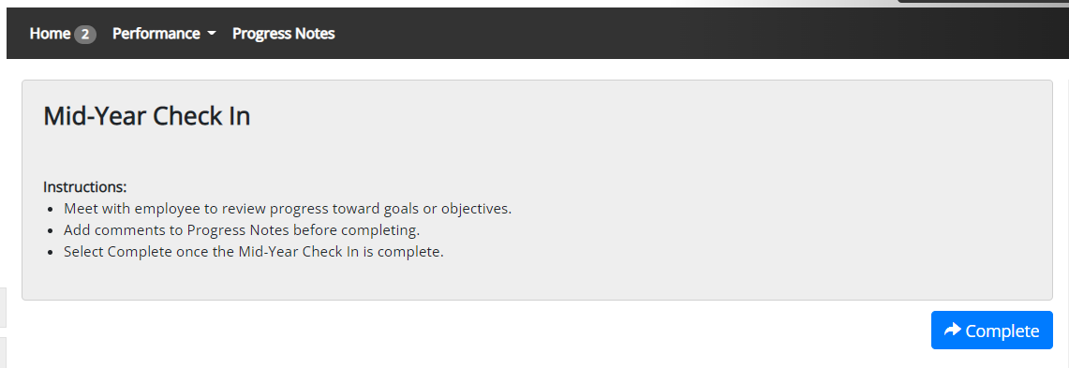
• Adding a co-reviewer allows the supervisor to identify another individual who can perform all the same steps as the supervisor.
Mid-Year Check In
Once the middle of the review cycle is reached, the supervisor will meet with the employee to review progress toward goals or objectives, and select “Complete” once the Check In is complete. To see notes on how to complete a Progress Note, please see slides 23-25.

Slide 8
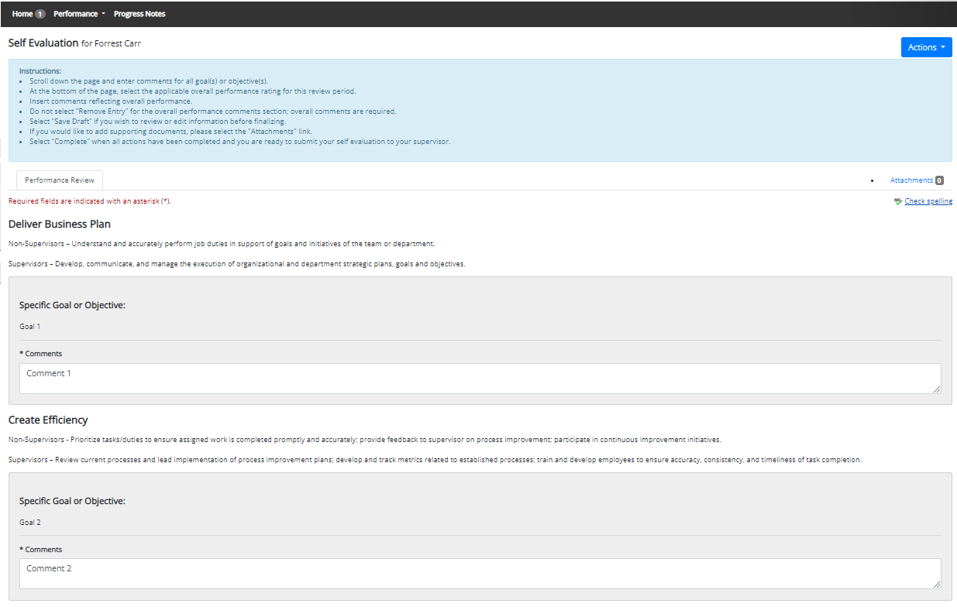
Complete Self-Evaluation
At the end of the review period, the next step in the evaluation process will be the employee completion of the Self-Evaluation.
The employee will enter comments on each goal, select their overall rating from the rating scale, and add overall comments. The employee can add attachments to the self-evaluation if desired.
To save a copy while in progress, select “Save Draft,” when all work is complete, select “Complete.”

Slide 9
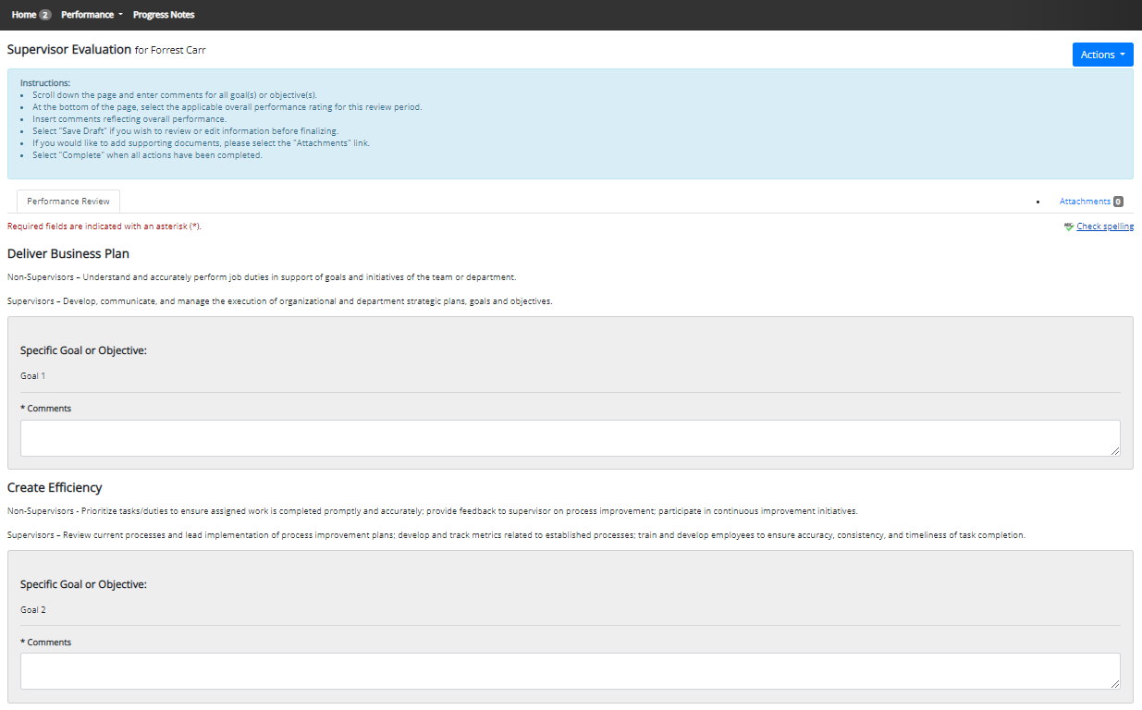
Supervisor Evaluation
Once the self evaluation is complete, the supervisor will be notified that the Supervisor Evaluation is open.
When completing the evaluation, supervisors are encouraged to review the self evaluation, progress notes, attachments, and any collected multi-rater feedback to aid in the evaluation process.
The supervisor will enter comments for each of the goals, select the overall rating for the review period and enter overall comments.
Scroll down the page to select “Save Draft” to save work in progress, and select “Complete” once the review is complete.

Slide 10
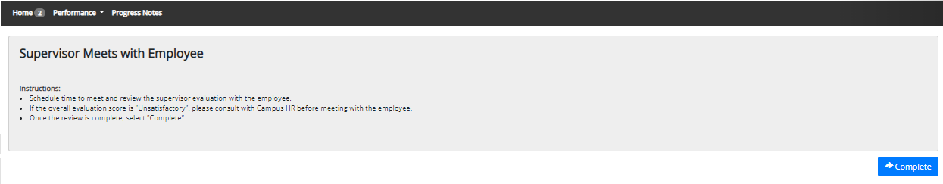
End of Year Review Meeting
Following completion of the Supervisor Evaluation, the supervisor should schedule a meeting with the employee to provide feedback on goals and the overall evaluation score for the review period.

Slide 11
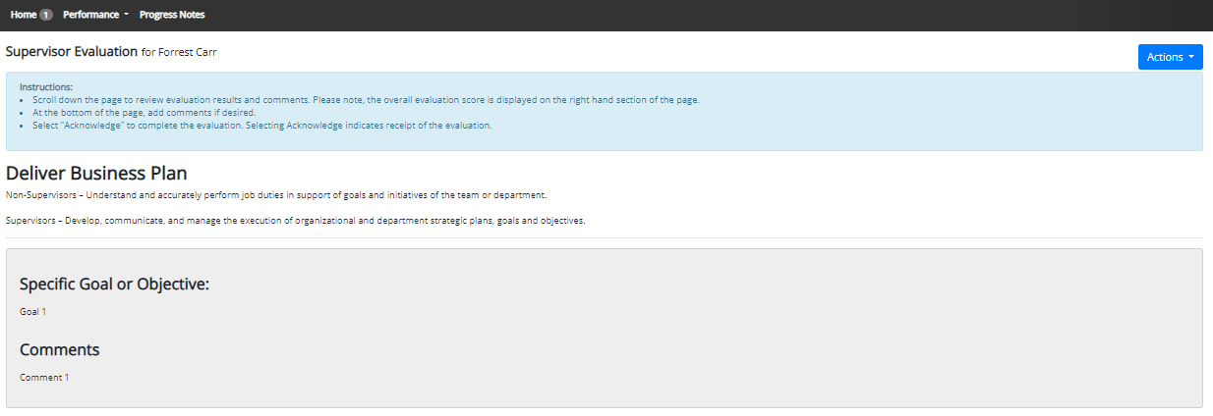
Employee Acknowledges Evaluation
Once the End of Year Review Meeting has concluded, the employee will receive an email notification directing them to complete the acknowledgement of the evaluation. This document will contain the supervisor’s comments and the overall review score.

Slide 12
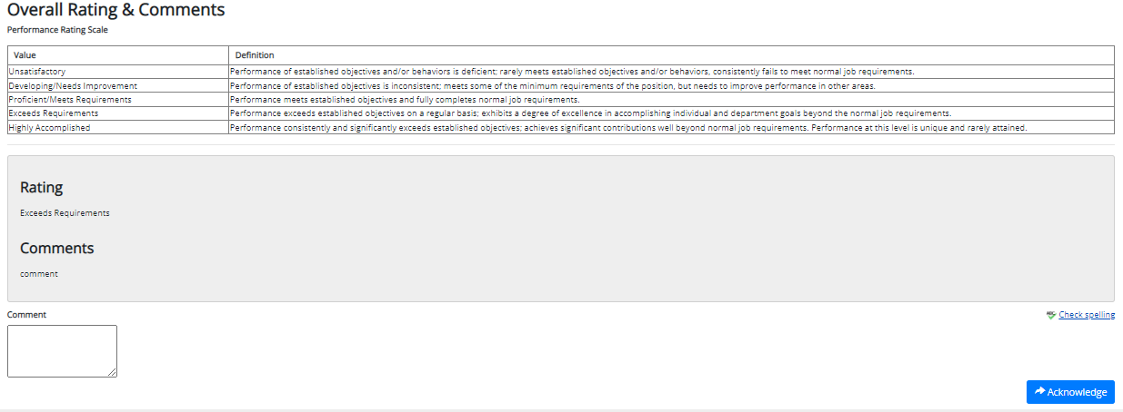
Employee Acknowledges Evaluation (cont.)
The employee can review the content of the evaluation, scroll to the bottom of the page to see the overall rating, add any optional comments if desired, and click on the “Acknowledge” button to indicate receipt of the evaluation.

Slide 13
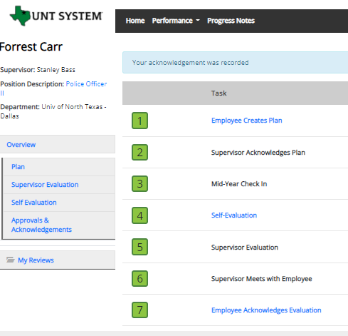
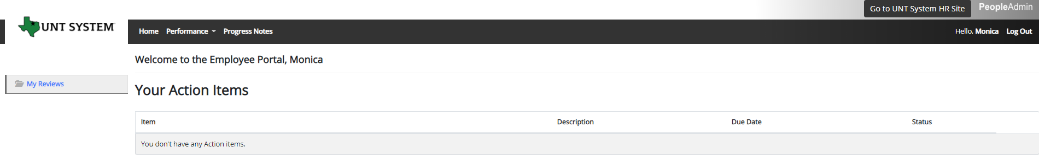
Completed Evaluation
Once the employee submits their acknowledgement, all tasks and action items are complete for this evaluation. All steps in the task list will have a green indicator and there will be no more action items pertaining to this evaluation.

Slide 14
Contacts
Dallas Campus HR Team
  Performance management concerns, discussion about unsatisfactory ratings, assistance with performance system
  Email: performanceevals@untdallas.edu
  Phone: 972-338-1410

Slide 15
Appendix

Slide 16
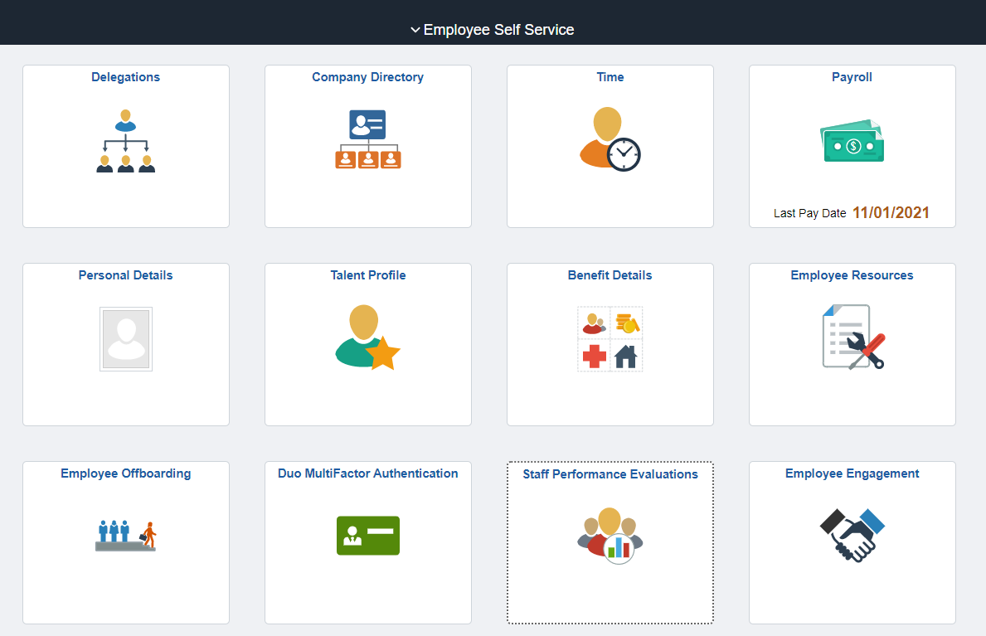
Access via Employee Portal
https://my.untsystem.edu

Slide 17
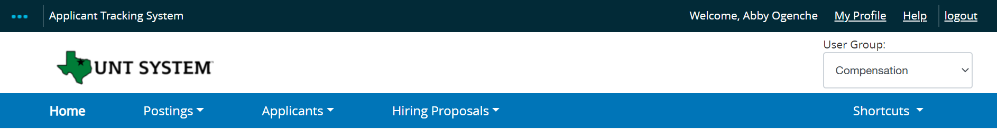
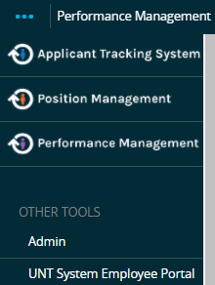
Access via PeopleAdmin
The employee portal can also be accessed through the PeopleAdmin System at https://jobs.untsystem.edu/hr
by clicking on the three dots in the top left corner of the page and then selecting “UNT System Employee Portal”

Slide 18
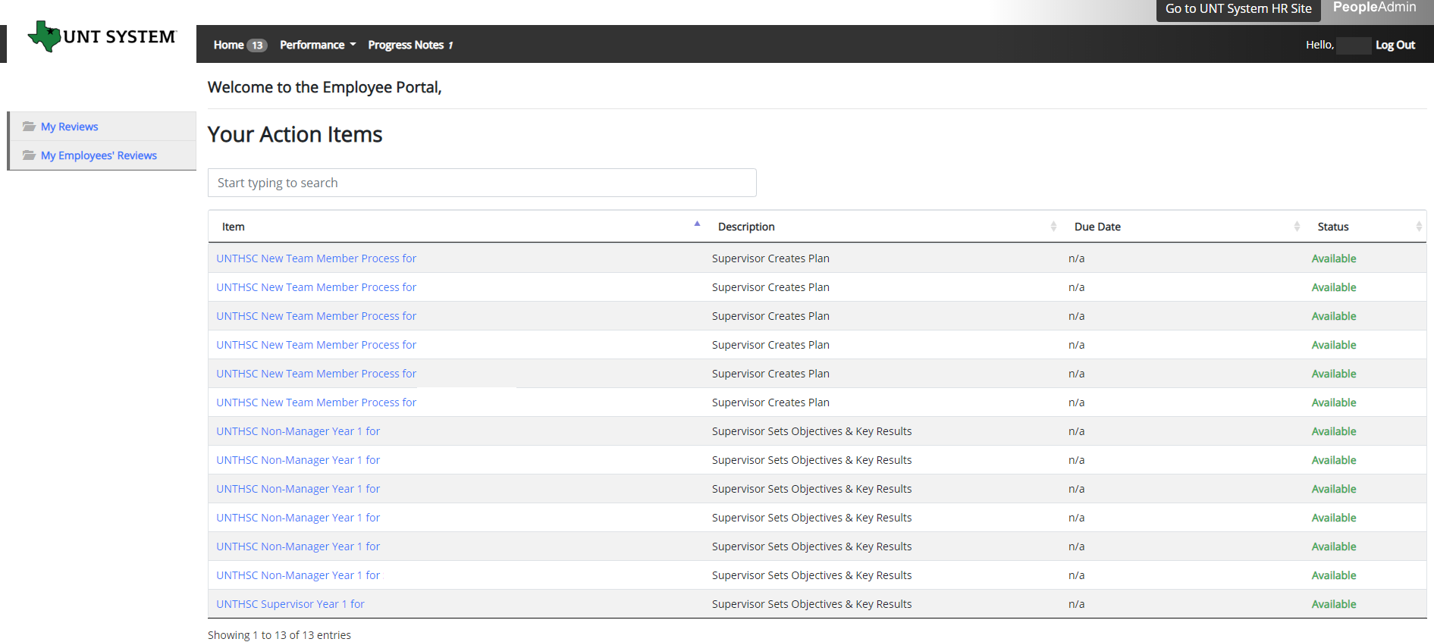
Navigation
The Home screen gives you a list of items that require you to take an action, this will include tasks related to your own evaluation and for supervisors, this will also include tasks for those you supervise.

Slide 19
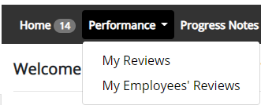
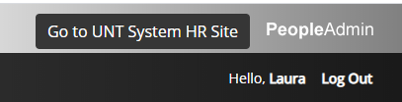

Navigation (cont.)
The Performance button repeats the My Reviews
and My Employees’ Reviews links found on the left
side of the screen
Clicking the Go to UNT System HR Site takes the user out of the employee portal and back to the Applicant Tracking System or Performance Management module.
The Log Out button ends the PeopleAdmin session requiring the user to sign in once more in order to access the system.

Slide 20
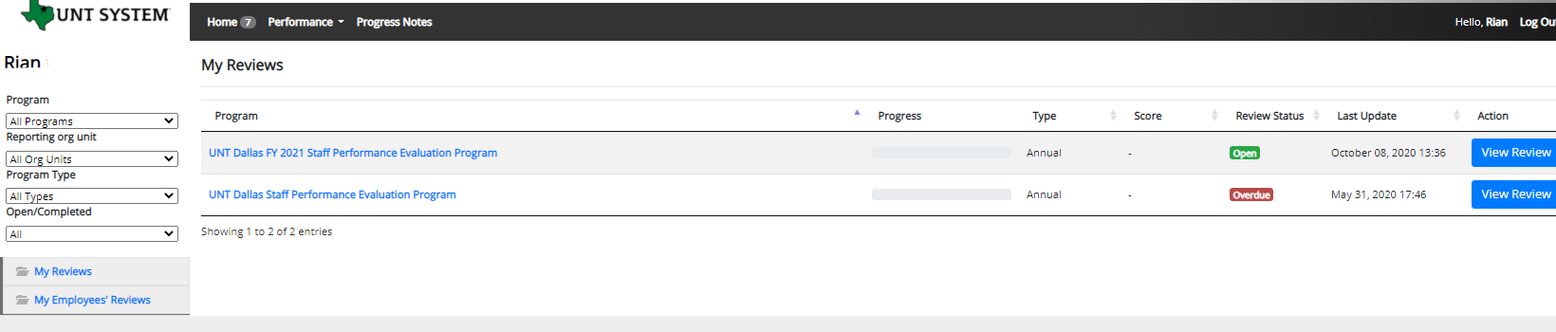
Navigation (cont.)
The “My Reviews” link allows employees to view their own evaluation, as well as the status of the review.
This is also where employees will be able to view evaluations which have already been completed within the PeopleAdmin System.

Slide 21

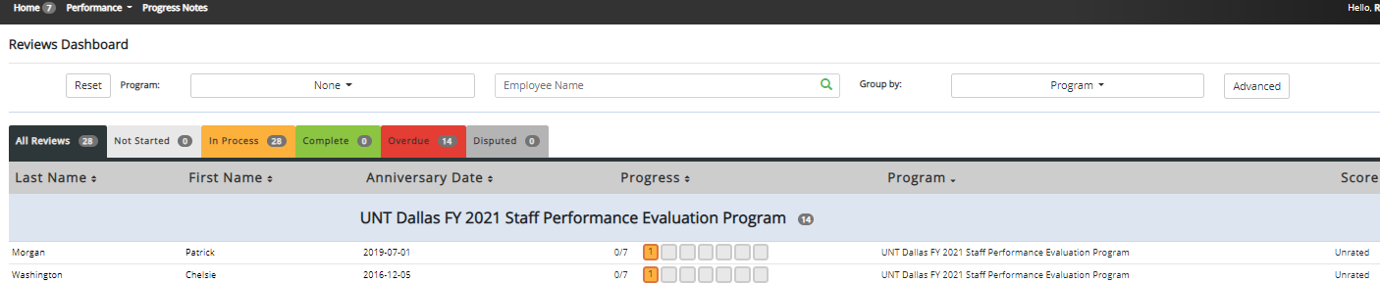
Navigation (cont.)
Supervisors may also use the available search filters in order to more quickly locate employee evaluations
The “My Employee’s Reviews” link takes you to the Reviews Dashboard which lists all employees, along with what stage of the employee evaluation they are currently on.
The available color-coded, pre-filtered tabs are:
All Reviews
Not Started
In Process
Complete
Overdue
*Please note that the Disputed tab will not be used*

Slide 22
Features of Performance Module
Supervisors can access review information for all direct reports in one location, including status of all evaluation steps.
Second-level and higher managers (department heads, deans, VPs, etc.) can access review information for all employees within their organizational structure.
Automatic notifications will be sent via email as program tasks open, become due, or are overdue.
Progress notes and attachments can be easily stored within the system.

Slide 23
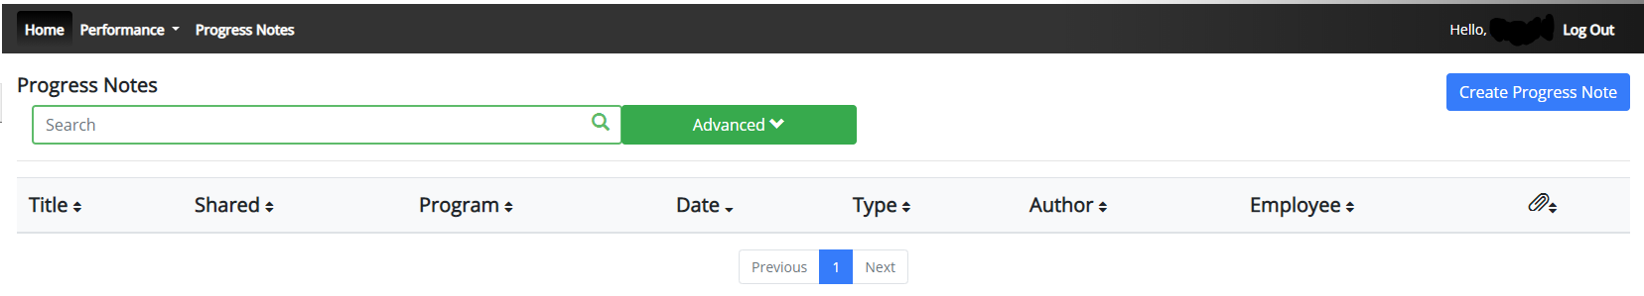
Progress Notes
Progress notes can be added at any time during the evaluation process and allow the supervisor as well as the employee to document achievements and/or important occurrences throughout the year.
To add a progress note, click on the “Progress Notes” link in the main menu, then click the “Create Progress Note” button.
It is highly encouraged that supervisors add progress notes detailing mid-year and year-end conversations. Notes should include a brief overview of the progress the individual has made towards their goals.

Slide 24
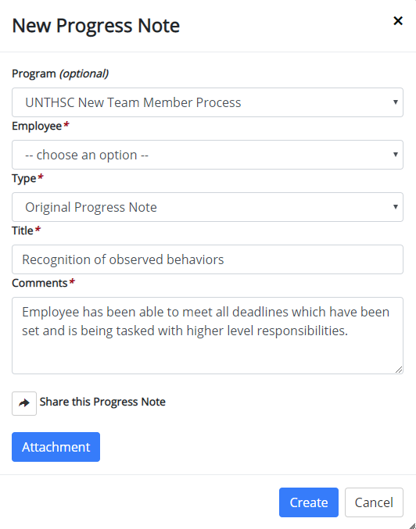
Progress Notes (cont.)
Progress notes may either be shared between the supervisor and employee or they may be set to be only viewed by the employee or supervisor who entered them. To share a progress note, click the “Share the Progress Note” button.
Supporting documents may also be added to progress notes by clicking the “Attachment” link.
Click “Create” in order to add the progress note.

Slide 25
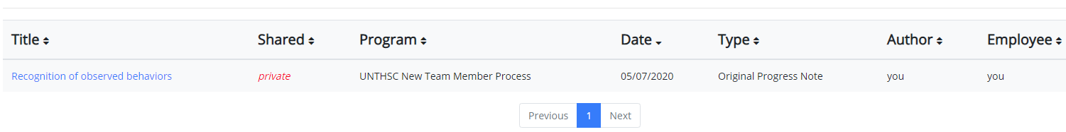
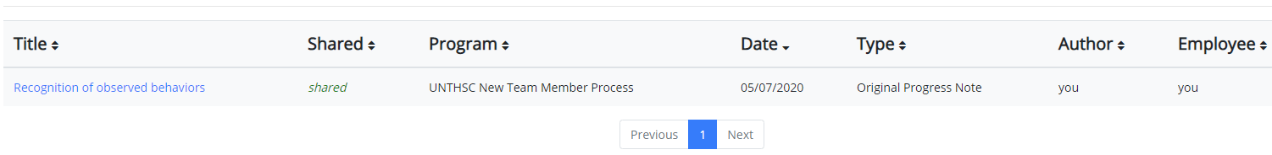
Progress Notes (cont.)
Clicking on the “Progress Notes” link also allows you to view any progress note(s) created by or shared with the individual.

Slide 26
Additional Reviewers
The system allows for feedback from other UNT World employees
  Co-Reviewer – Use this function if another reviewer should have full feedback capabilities to the employee’s evaluation. This might be used for someone who has a split reporting relationship or someone who recently transferred to a new job during the last year. The supervisor and co-reviewer will need to discuss who will be responsible for completion and submission of the evaluation steps.
  Multi-Rater – Use this function to invite feedback from other UNT World employees (customers, peers, etc.) on the employee’s performance. The multi-rater has no access to read or edit the employee’s evaluation.

Slide 27
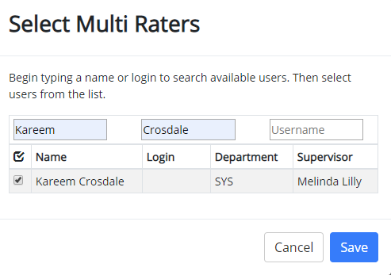
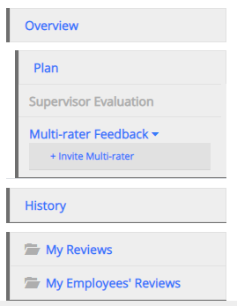
Multi-Rater Feedback Feature
A supervisor can request performance feedback from other UNT World employees
The supervisor will click on
“Multi-rater Feedback” in the left menu
and select the “Invite Multi-rater” link.
Enter the name of the person or persons
to be invited, check the box by their name
and click the “Save” button.
The Multi-rater will receive an email notifying them of the request and they can access the multi-rater form through their performance portal Home page.

Slide 28
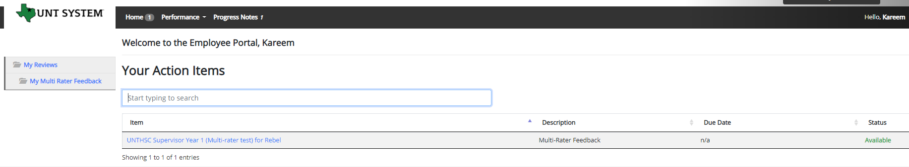
Multi-Rater (cont.)
Once a Multi-rater has been added to an evaluation, the Multi-rater feedback will be listed as an action item and can be found on the Home page when the Multi-rater logs into the portal.

Slide 29
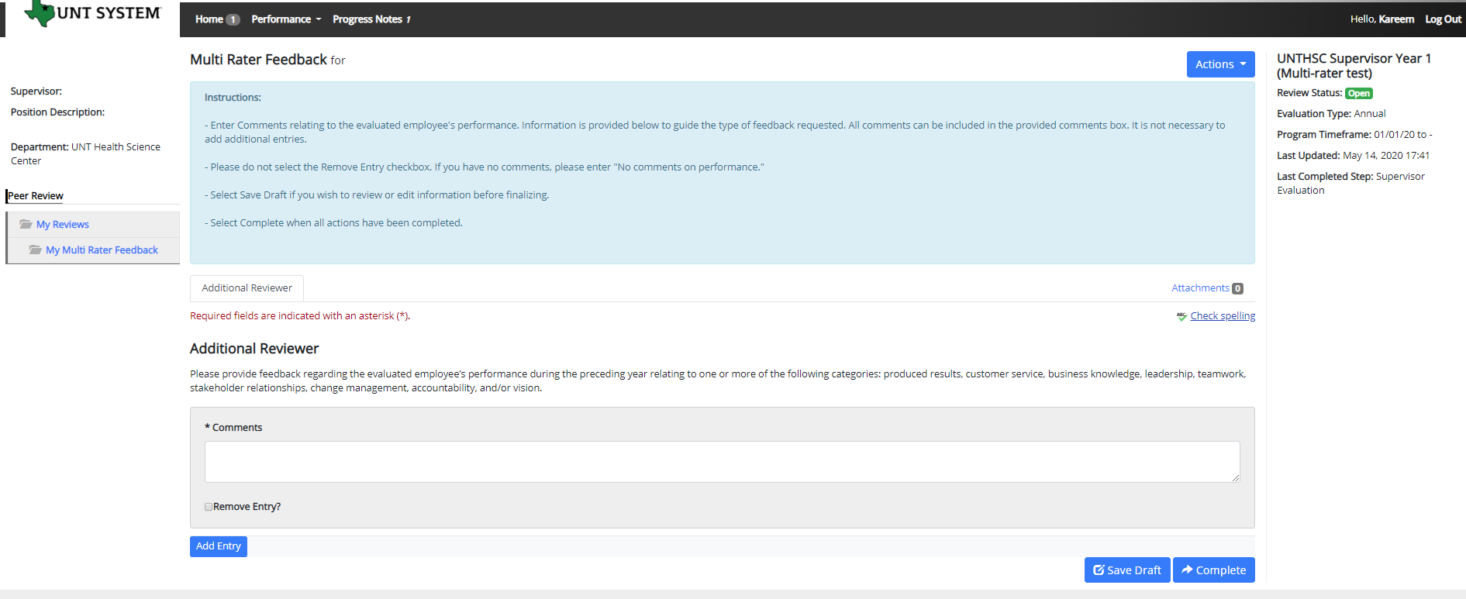
Multi-Rater (cont.)
The Multi-rater will enter all comments/feedback within the available “Comments” box, there is no need to add a new entry. They will then have the option of saving as a draft for further review using the “Save Draft” link, or they may select “Complete” to conclude the multi-rater feedback.

Slide 30
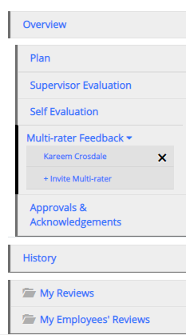
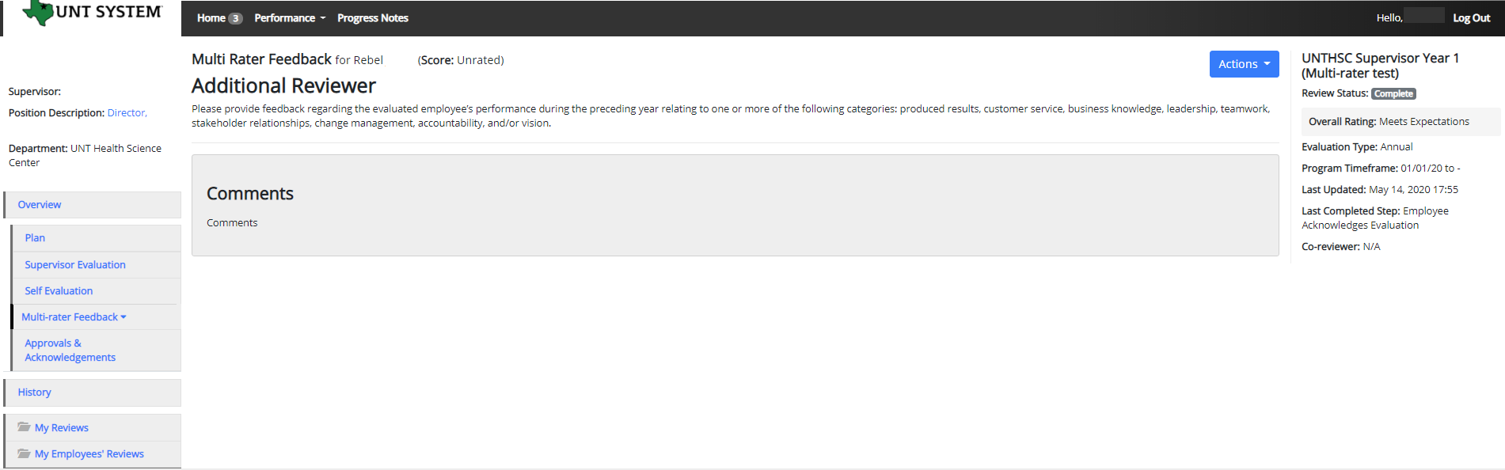
Multi-Rater – Supervisor’s View
To view the Multi-Rater feedback, the supervisor will select the employee’s name from the left menu under the Multi-Rater feedback drop-down list.
The supervisor will then be able to see any comments made by the Multi-Rater.
Multi-rater comments are only visible to the supervisor and the multi-rater, employees are not able to access these comments.

Slide 31
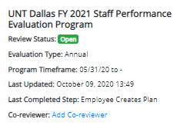
• Adding a co-reviewer allows the supervisor to identify another individual who can perform all the same steps as the supervisor.
Co-Reviewer Feature
Adding a co-reviewer allows the supervisor to identify another individual who can perform all the same evaluation steps as the supervisor. This function can be utilized if another reviewer should have full feedback capabilities to the employee’s evaluation. The co-reviewer has the ability to perform all the same steps as the supervisor.
To add a Co-reviewer, the supervisor will click on the “Add Co-reviewer” link on the right panel.
A Co-reviewer can be added at any point prior to the completion of the Supervisor Evaluation.
It must also be noted that the Co-reviewer and the supervisor will be sharing the forms allowing only one of them to make the final submission.
The co-reviewer feature might be used for someone who has a split reporting relationship or someone who recently transferred to a new job. The supervisor and co-reviewer will need to discuss who will be responsible for completion and submission of the evaluation steps. Note that only one person can submit the supervisor evaluation by clicking complete. Otherwise, save as draft and the co-reviewer will be notified that there is a pending action item for them to complete. The supervisor or co-reviewer may also add attachments by selecting the attachment link.

Slide 32
E-mail Notification Feature
E-mail notifications will be sent for the following actions:
  A program step opens for completion
  A due date is within 7 days
  A due date is today
  A program step is overdue
E-mails will include information on what steps are open and will provide a link to the system.
System generated e-mails will only be sent to supervisors and employees. The system should send no more than one message per day.

